Slide 1
MMO Virtual Item Marketplace
Group Members: Alexis Kaufman, Amila Haque, Brandon Maweu, Justin Jeirles, Kashvi Asokan, Brian Pham, Quintin Mitchell-Reyes, Ilan Ali, Shahreen Iqbal

Slide 2
Introduction
Our project centers around building a virtual item marketplace for an MMO (massively multiplayer online) game.
It’s completely separate from the main game, which makes it easier to implement into several different games with a few adjustments.
Having a separate marketplace also means that even if the main game is hacked, the information stored in the marketplace will remain safe.
Notes:
Kash

Slide 3
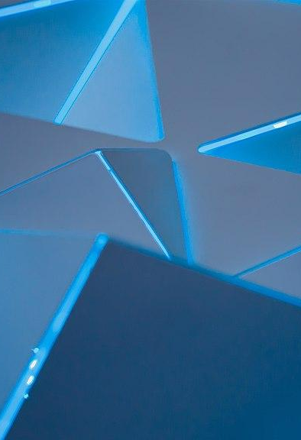
Our Motivation
Our team formed due to a mutual enjoyment of video games and game development, and we wanted to try our hand at something that could potentially prove to be useful in the future.
We noticed that most games feature an attached marketplace, so we decided to create a virtual marketplace for MMO games that could be easily implemented.
Notes:
Brandon

Slide 4
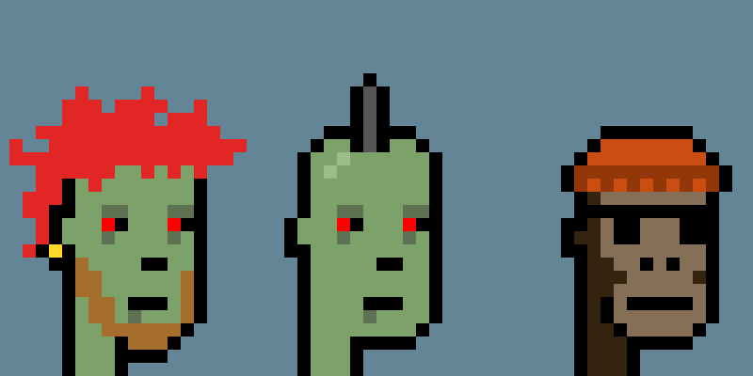
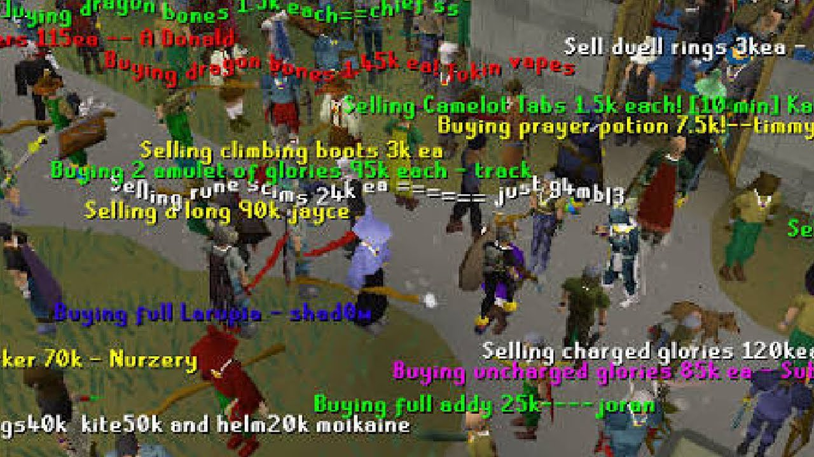
Related Works
CryptoPunks
Runescape Marketplace
CryptoPunks is an example of a system that has digital collectibles, specifically on the blockchain.
Runescape Marketplace is a marketplace in the MMO game Runescape. The marketplace in the game is very similar to what we plan to create because it sells several things like consumables, armor/costumes, animations, pets, etc.
Notes:
CryptoPunks is an example of a system that has digital collectibles, specifically on the blockchain. While our project has a simpler scope and does not involve NFTs, this site lets users buy, sell, and trade digital assets in the form of 24x24 pixel art characters.
Runescape Marketplace is a marketplace in the MMO game Runescape. The marketplace in the game is very similar to what we plan to create because it sells several things like consumables, armor/costumes, animations, pets, etc. The items are also categorized and have different attributes.

Slide 5
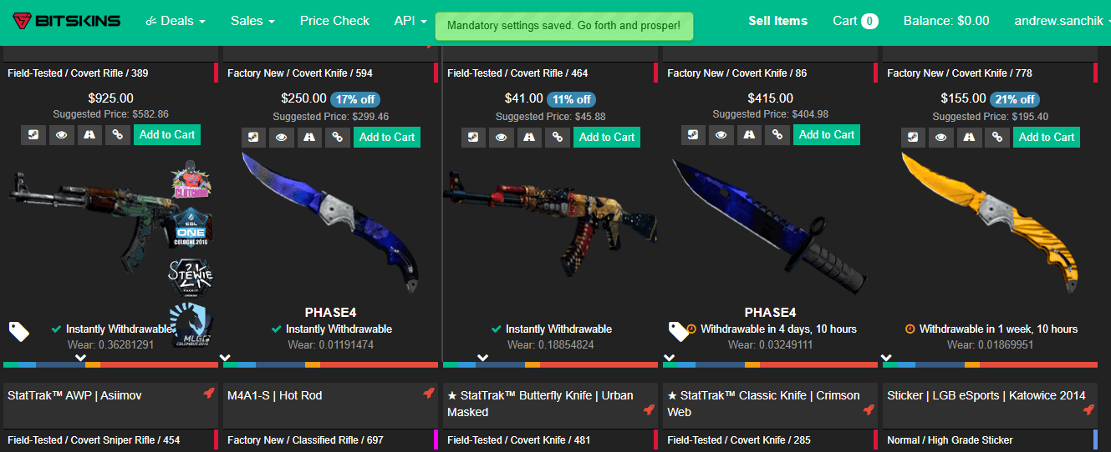
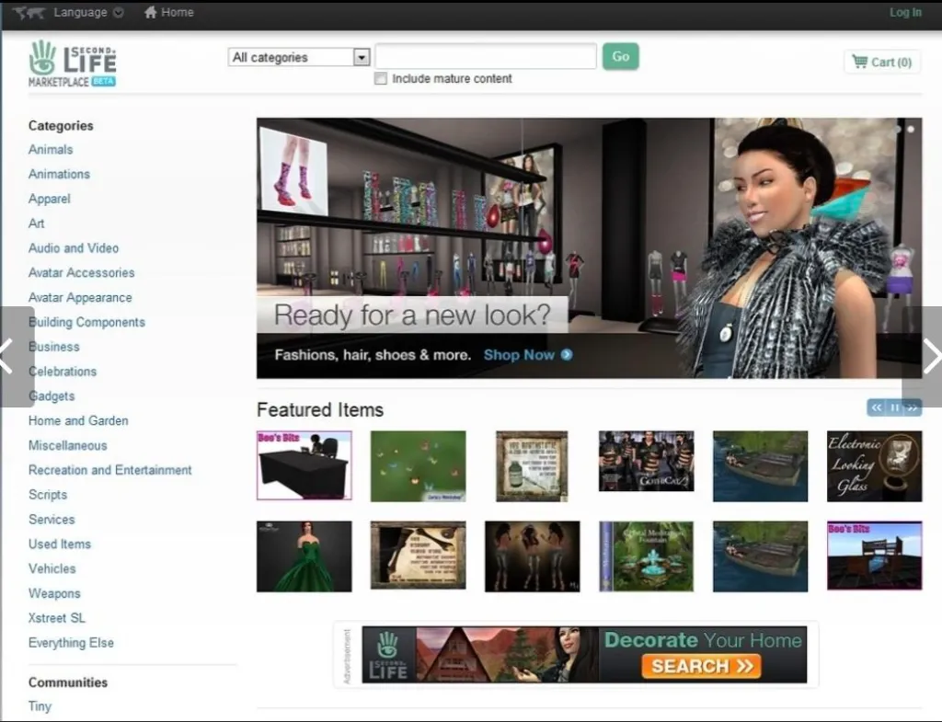
Related Works
BitSkins
Second Life Marketplace
BitSkins is a marketplace that allows players from Counter-Strike: Global Offensive (CS) and Dota 2 to buy, sell, and trade in-game items for real-world currency.
Second Life Marketplace is a virtual marketplace where users can buy and sell virtual goods such as clothing, buildings, vehicles, and even services.
Notes:
BitSkins is a marketplace that allows players from Counter-Strike: Global Offensive (CS) and Dota 2 to buy, sell, and trade in-game items for real-world currency. BitSkins also showcases a transparent pricing system, enabling users to see the current market value of items, which aids in making informed buying and selling decisions.
Second Life Marketplace is a virtual marketplace where users can buy and sell virtual goods such as clothing, buildings, vehicles, and even services. The marketplace also has its own currency, which is reflected in the game, called the Linden Dollar (L).

Slide 6
Tech Stack
React Typescript
Next.js
PostgreSQL
Express
Notes:
Brian Pham

Slide 7
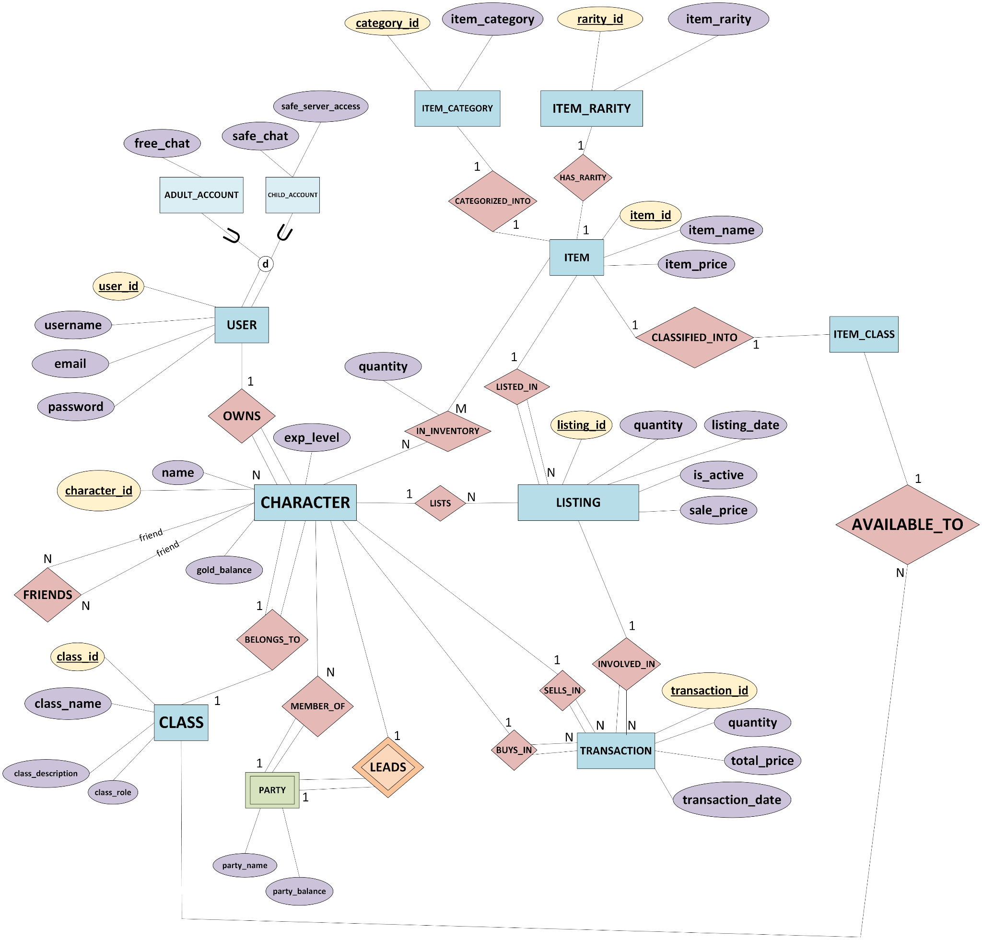
EER Diagram
Notes:
Amila

Slide 8
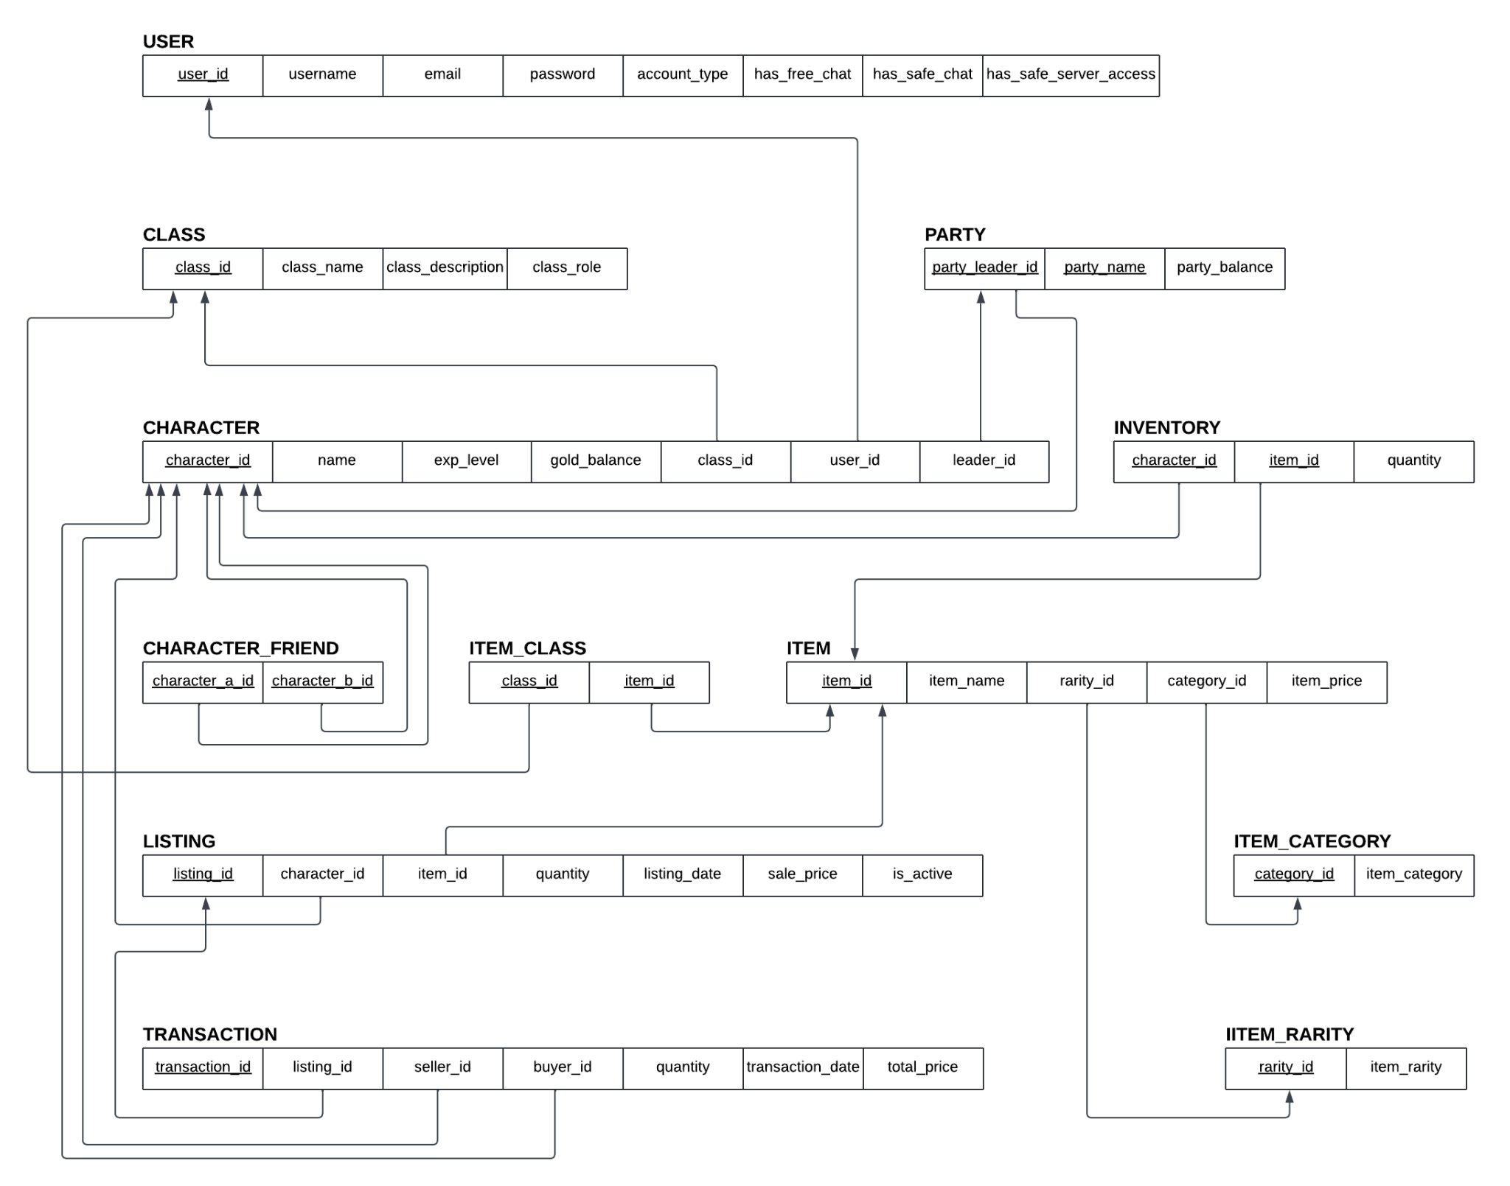
Relational Diagram
Notes:
Quintin

Slide 9
Operations
Query:
Insert:
Delete:
Logging into an account,
viewing all listings
Registration, Inserting values into user, class, character, party, item, etc., tables
Deleting a listing
Update:
Quit:
Updating a listing
Logging out of the app
Notes:
Justin

